Slide 1


Assignment #3
Password Cracking
Dr: Nabil Ismail By :Amira Mohamed Menshawy

Slide 2
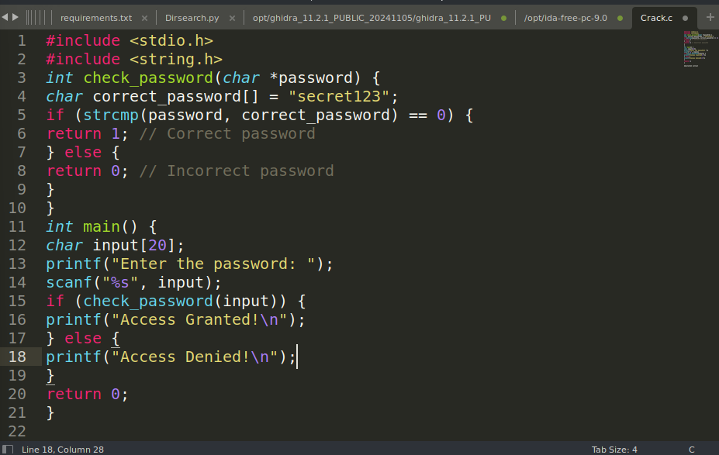
the main function initializes the program, manages user input, and interprets the result of the password check to determine access.

Slide 3
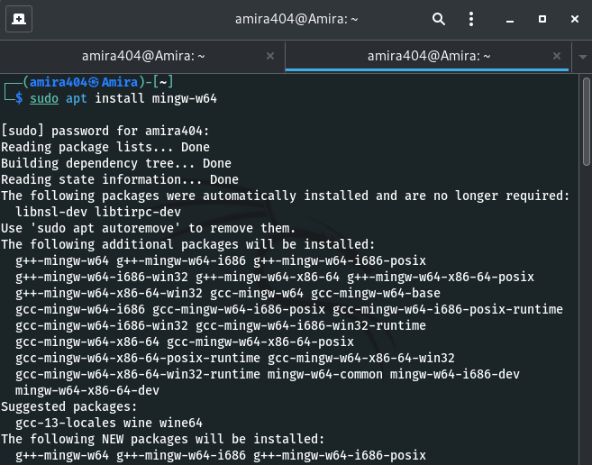
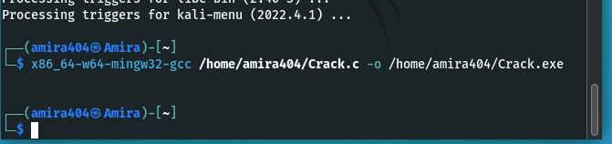
you need to compile the Crack.c source code into an executable file. This can be done using the MinGW-w64 compiler .
Compile the .c file to a Windows executable (.exe) :you can compile the Crack.c file into a Windows PE format
The x86_64-w64-mingw32-gcc is the cross-compiler for Windows executables.
sudo apt install mingw-w64
x86_64-w64-mingw32-gcc /home/amira404/Crack.c -o /home/amira404/Crack.exe

Slide 4
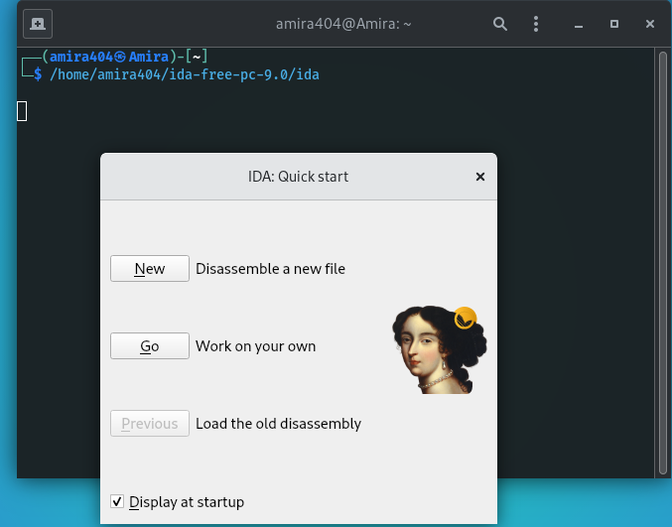
Let's use a reverse engineering tool to crack the password.
After Launch, Let’s Run IDA Free tool
/home/amira404/ida-free-pc-9.0/ida
Open ida
IDA is an Executable file in IDA-Free Tool

Slide 5
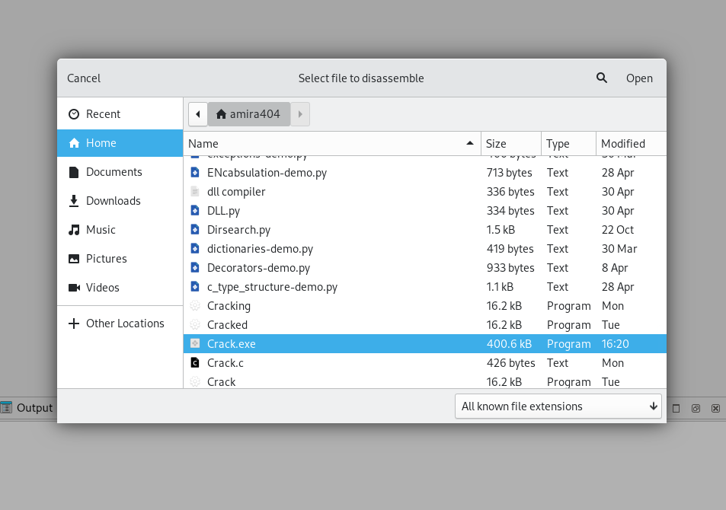
Load the PE file in IDA Crack.exe

Slide 6
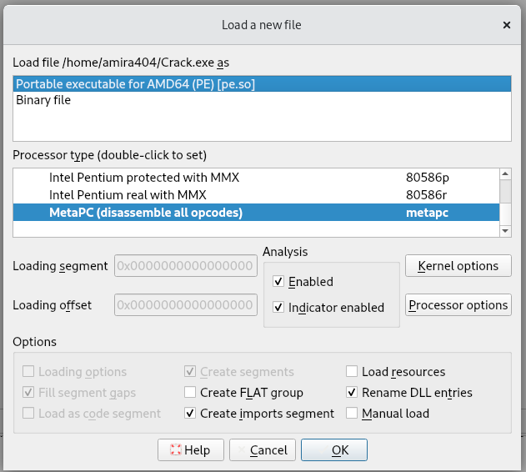
Let’s Analyze the file

Slide 7
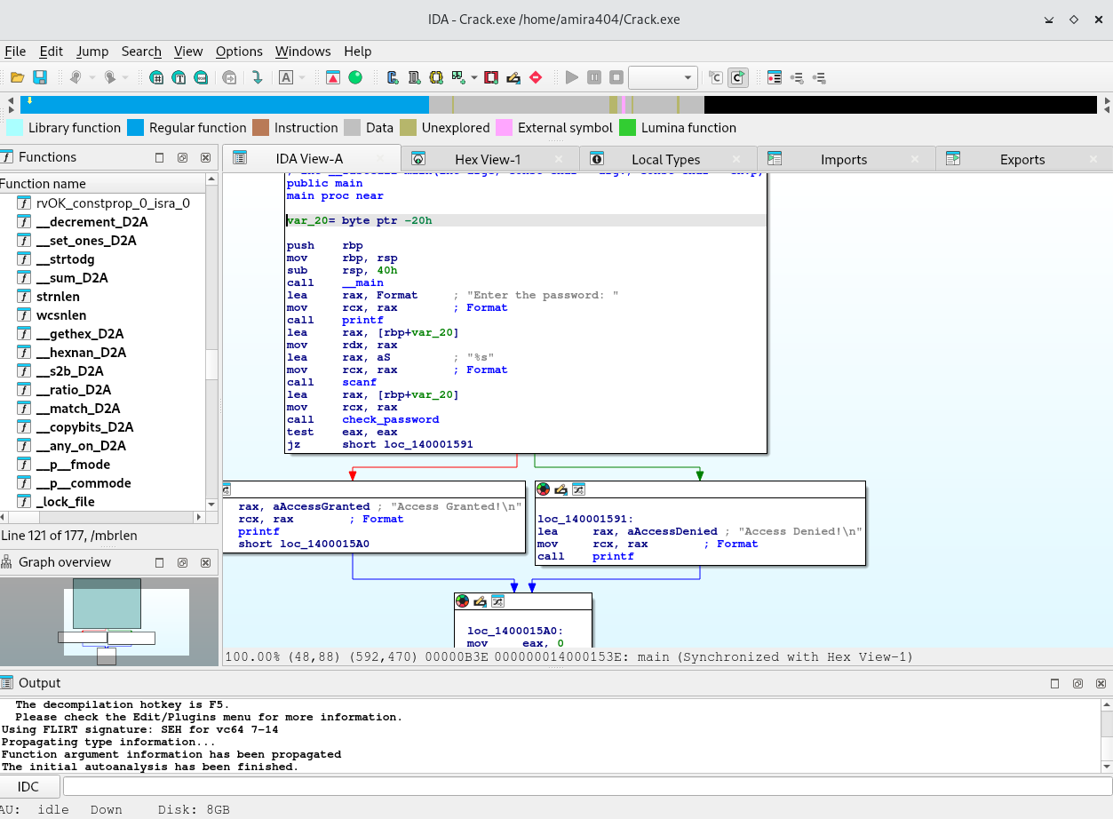
The file was successfully analyzed
What now we want to search for the password,
Passwords or other text strings are stored in memory in an unencrypted (or lightly encrypted) form.
You can search for text strings within the program (such as "password", "login", or "key").

Slide 8
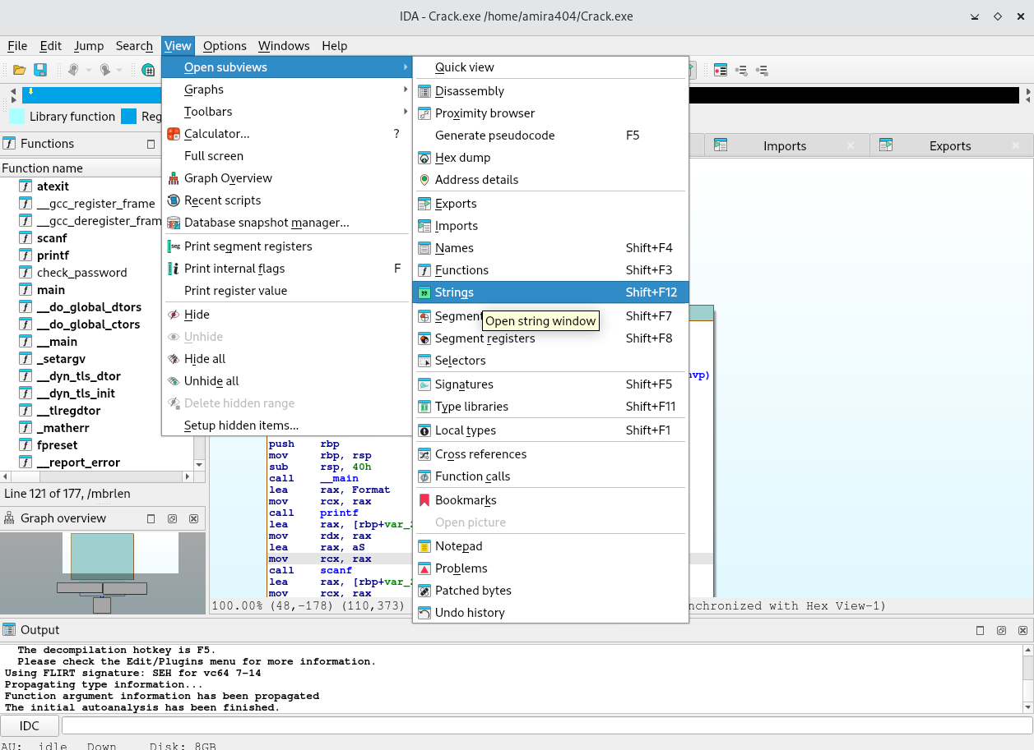
1-View 2-subviews 3-Strings

Slide 9
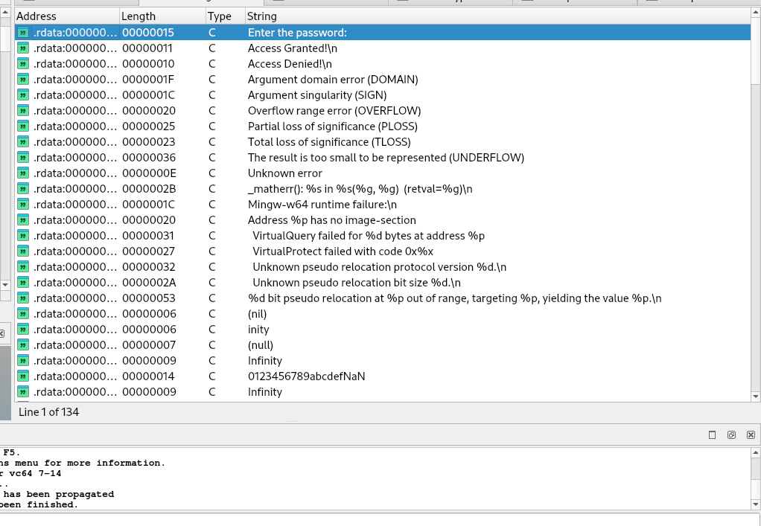

Slide 10
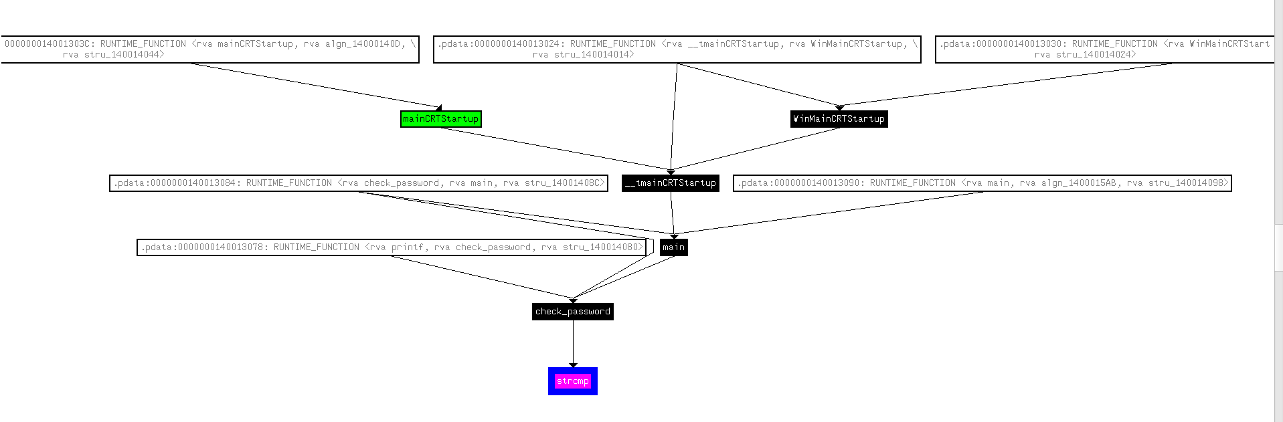
WinGraph32 - Xrefs to

Slide 11
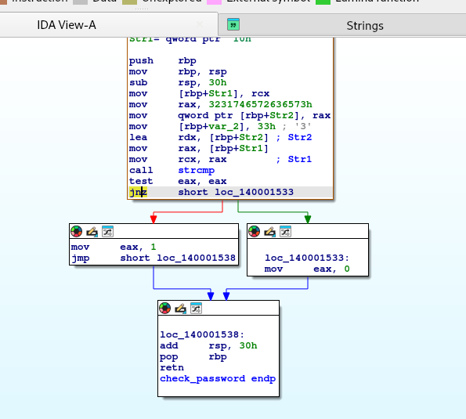
Will Jump here If not equal Zero

Slide 12
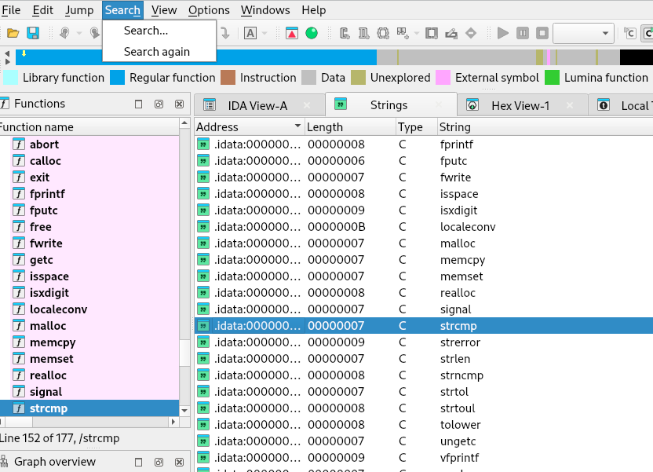
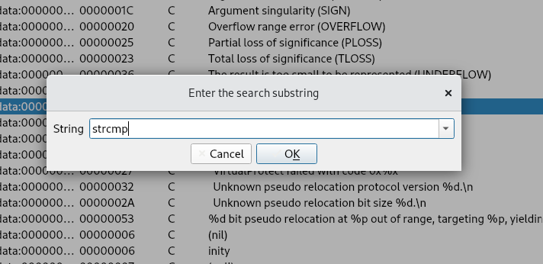
Look for functions that might compare the password. Typically, functions like strncmp , strcmp To compare text strings. -Scroll Down to find functions or use search

Slide 13
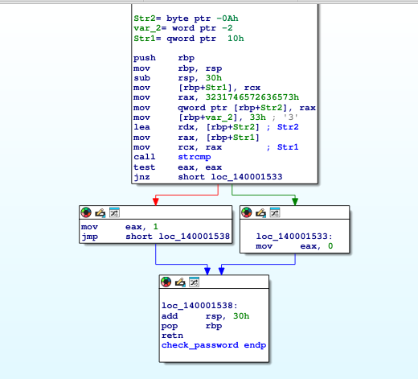
Control Flow Graph of Check_Password Function

Slide 14
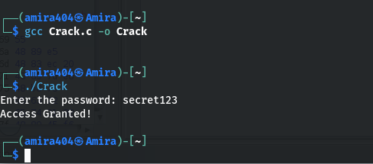
Access Granted
It works we have successfully cracked the password

Slide 15

Thank You

